Slide 1
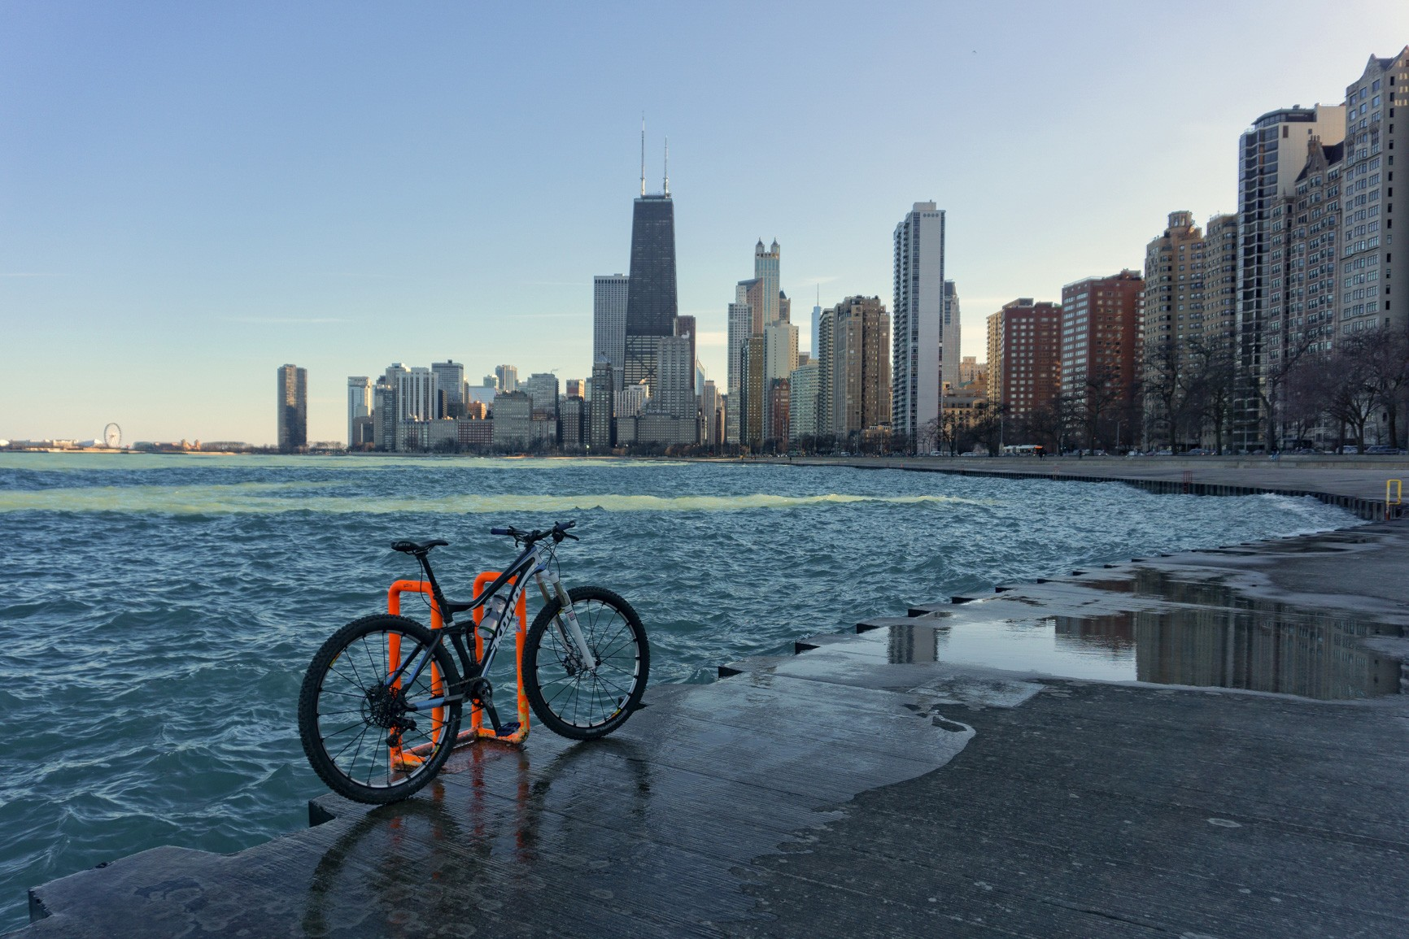
Cyclistic Bike-Share Case Study

Slide 2
Background / Business Task
Cyclistic is a bike-share company based in Chicago.
Their customers are categorized into two different groups:
Casual Riders: Customers who purchase single-ride or full-day passes.
Members: Customers who purchase annual memberships.
Cyclistic’s finance analysts have concluded that annual members are much more profitable than casual riders, and that maximizing the number of annual members is the key to the company’s future growth.
It is the job of Cyclistic’s data analysis team to analyze the differences between casual riders and members, with the goal of developing strategies aimed at converting casual riders into members.

Slide 3
Data
The data used for this project was derived from 12 spreadsheets, one for each month of the year 2022, containing information regarding customer bike-share activity throughout the year.
Each Spreadsheet contained 100,000 to 800,000 rows, as well as the following columns of information:
Ride_ID: A unique code identifying each instance of a ride.
Rideable_type: Denotes the type of bike used, electric or classic.
Started_at: Denotes the date and time a ride started.
Ended_at: Denotes the date and time a ride ended.
Member_casual: Denotes whether the customer was a casual rider or an annual member.
Ride_duration: Denotes the length of the ride, in minutes (created by subtracting the ended_at column by the started_at column).
Day_of_week: Uses numbers 1-7 to denote the day of the week a ride occurred on, 1 = Sunday, 2 = Monday, etc. (created using the WEEKDAY function in Microsoft Excel).

Slide 4
Data Cleaning
Before any data was analyzed, the following steps were taken to clean and format each spreadsheet:
Sort data by ‘started_at’ column.
Remove duplicate entries.
Format ‘started_at’ and ‘ended_at’ columns in the same formant (m/d/yyyy h:mm).
Remove rows with empty cells.
Add columns ‘ride_duration’ and ‘weekday’, as these were not in the spreadsheets to start.
Each spreadsheet contained about 100-200 rows of data containing a ride length longer than 24 hours. These rows were removed from the data due to their potential to skew the data, as well as being deemed not reflective of a genuine ride, as these were likely caused by a customer docking the bike incorrectly, or some other similar error.

Slide 5
Analysis
After the data cleaning was completed, the spreadsheets were imported into Microsoft SQL Server (SSMS), and combined into one table titled “Yearly_Data”, which contained nearly 5.6 million rows.
Behaviors and trends that were analyzed include the following:
Average trip length between casual customers and annual members.
Differences in casual and member trip lengths depending on both the day of the week and the month of the year.
Preferred bike type (classic or electric) among casual customers and annual members.
Total number of rides per day per customer type, as well as per month per customer type.
Charts were then created using Tableau to visualize findings of the analysis.

Slide 6
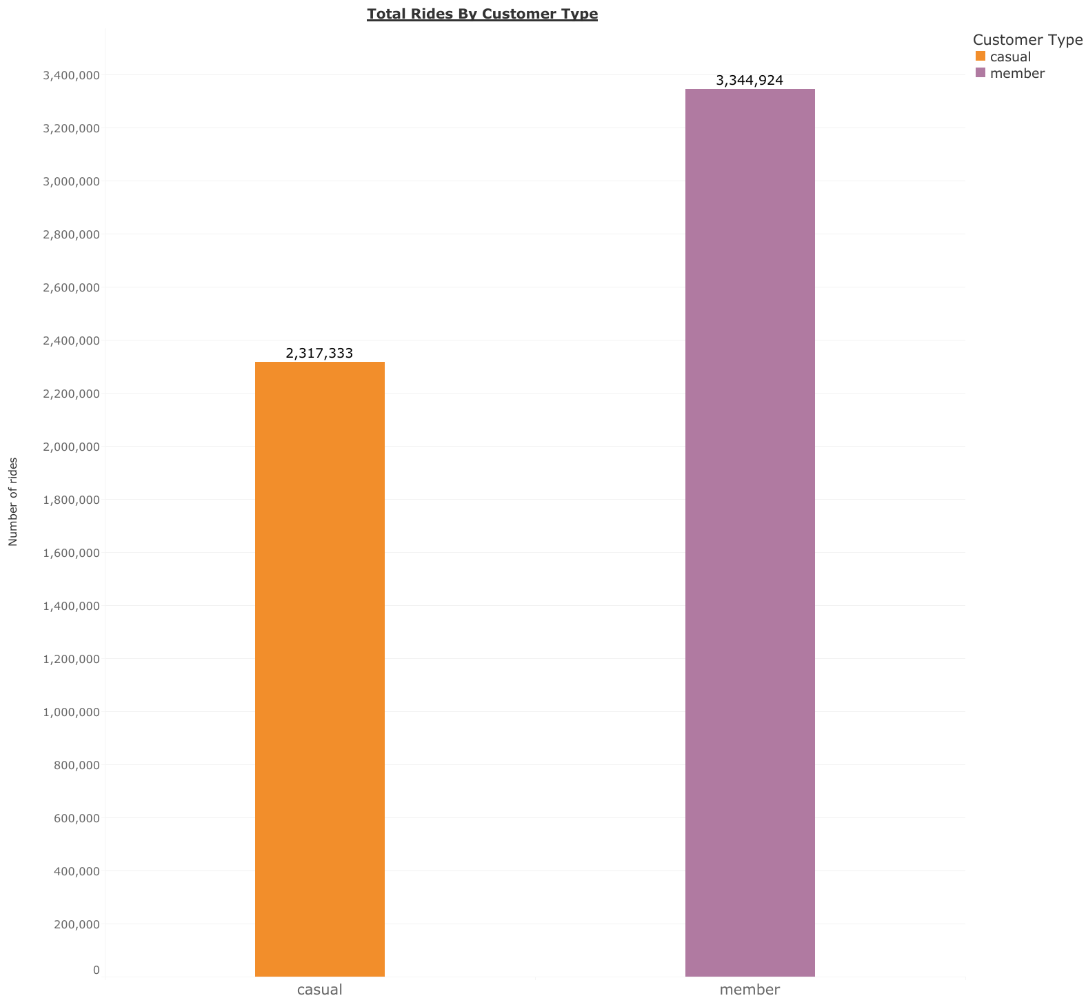
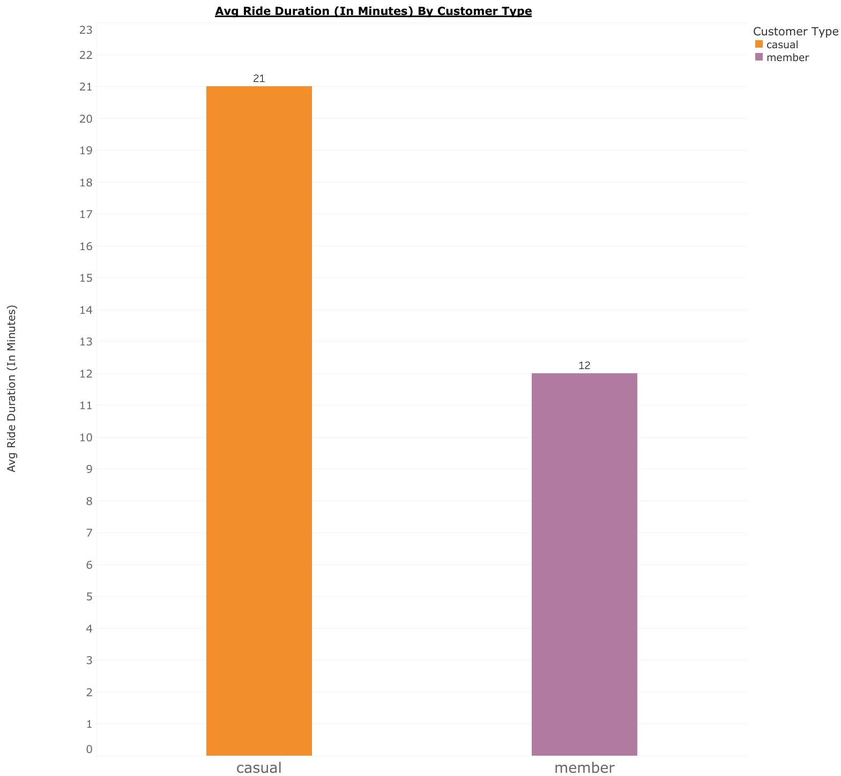
Findings
Annual members made up a larger share of the total number of rides, about 60 percent.
But casual customers rode for longer periods of time, as the average ride duration for a casual customer was almost twice as long as the average duration for an annual member.

Slide 7
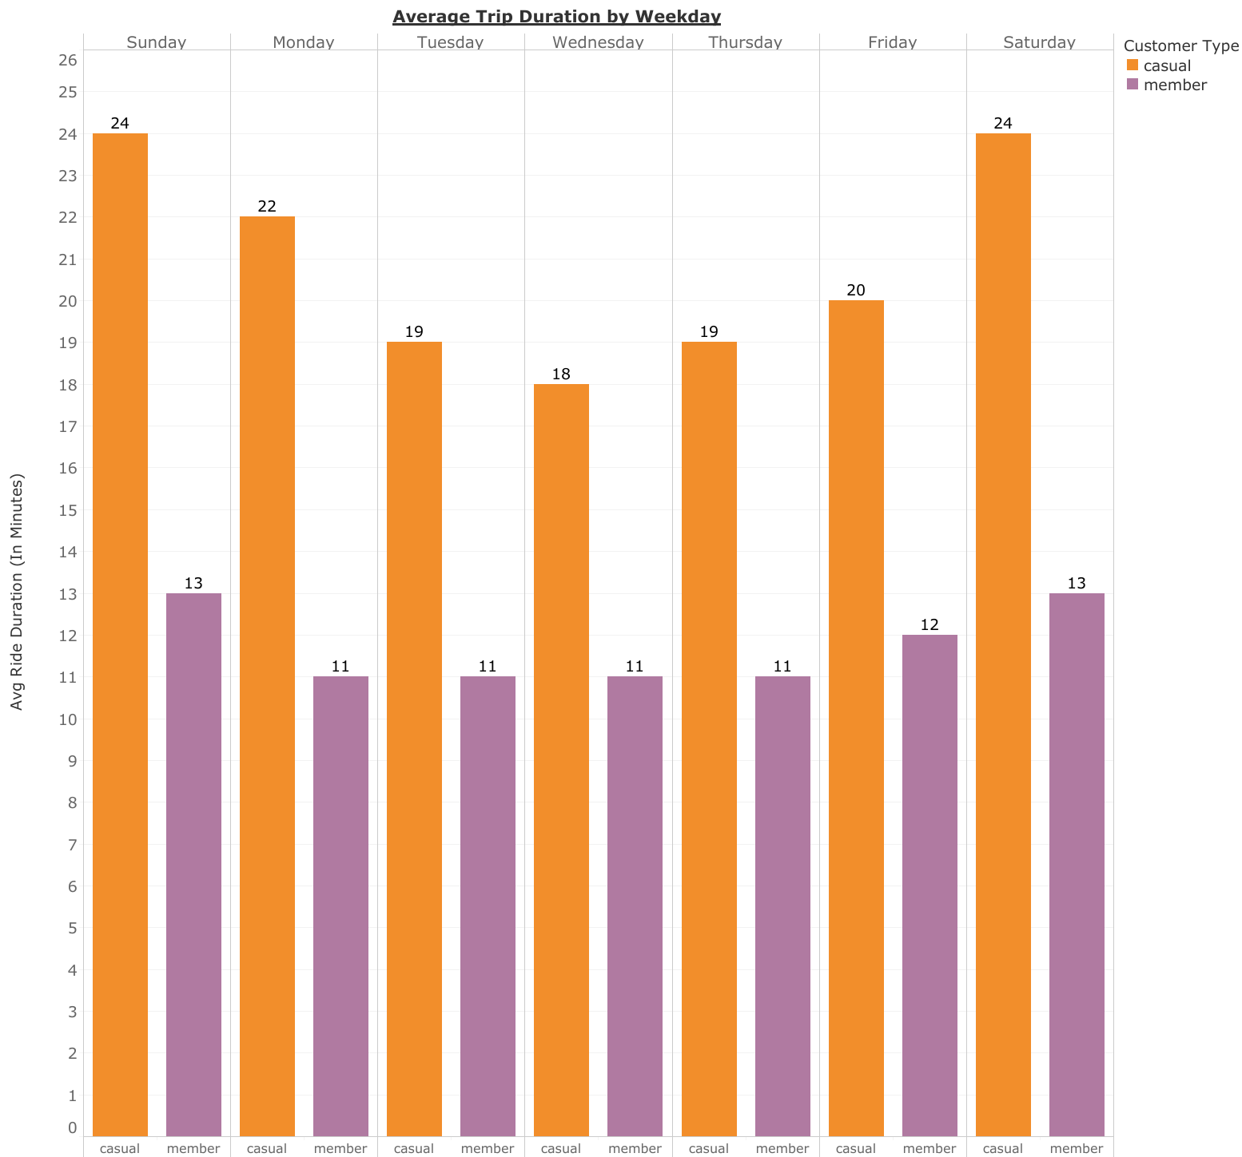
Average Trip Duration Per Weekday
Casual customers had longer average ride durations regardless of which day of the week it was.
Annual members have a more uniform distribution of average ride times, while casual customers have a U-shaped distribution, culminating with longer average ride times on the weekends.

Slide 8
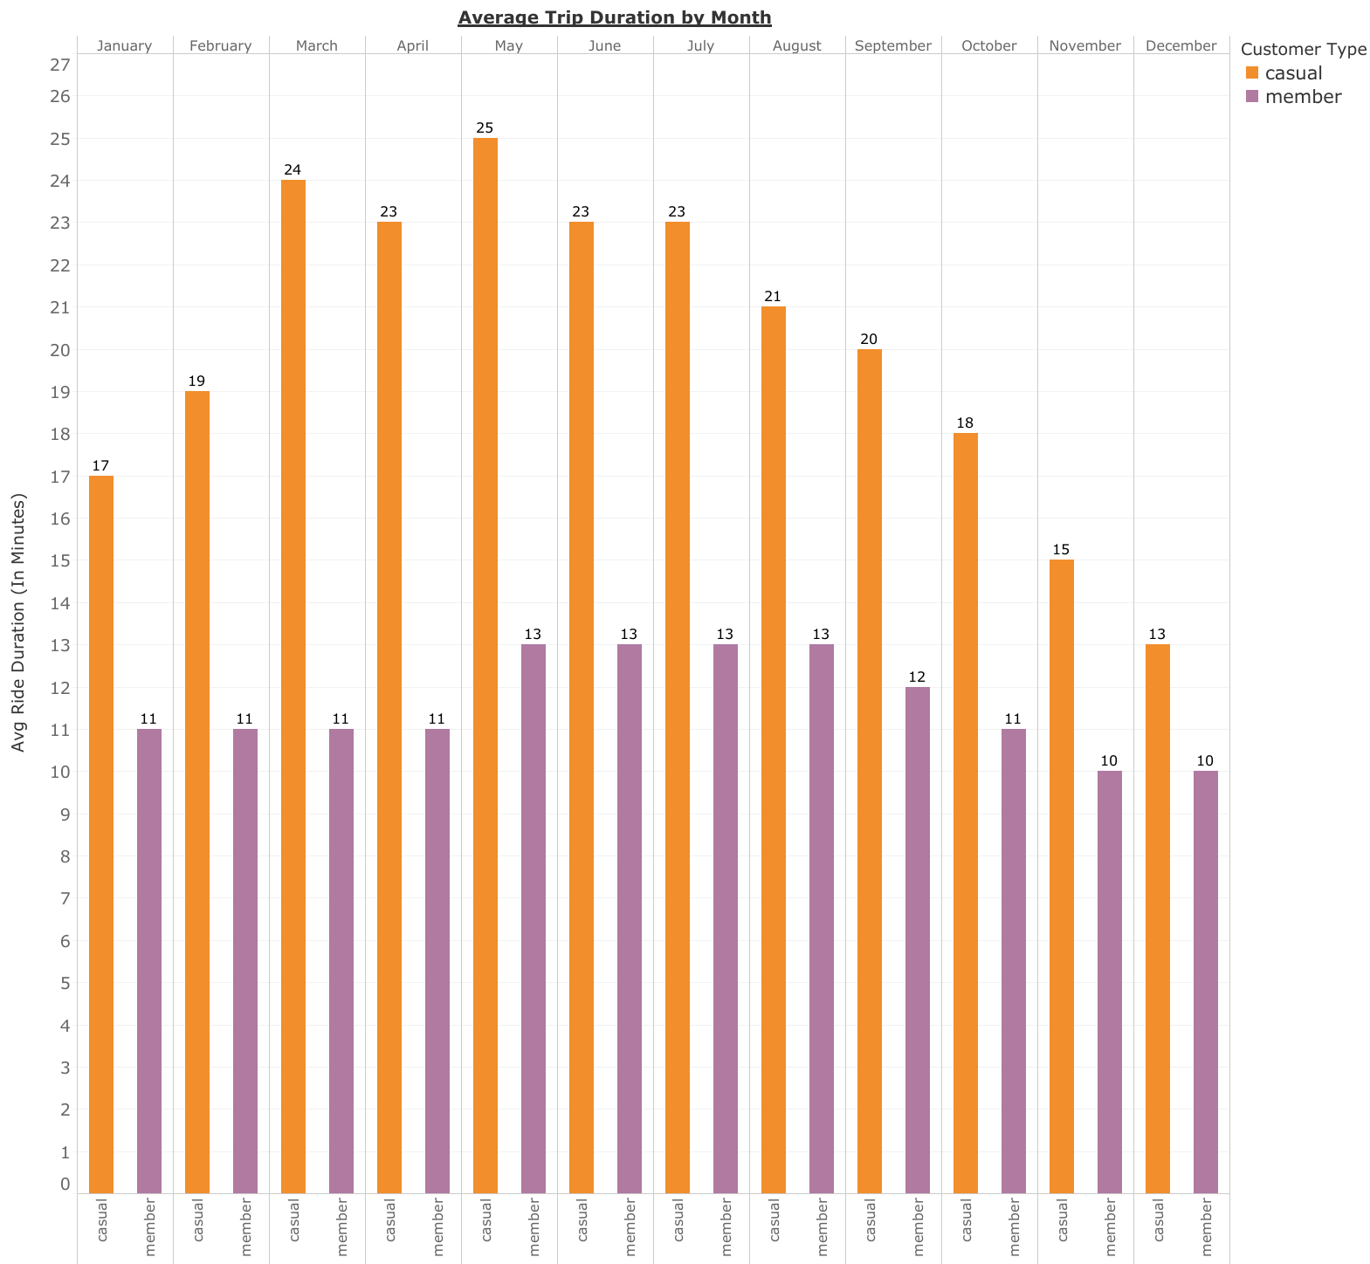
Average Trip Duration by Month
When looking at average trip duration by month, we see a similar uniform distribution among annual members, with a slight increase during the warmer months.
Trip duration for casual customers has a clearer increase during the warmer months as well as a clearer decrease during the colder months.

Slide 9
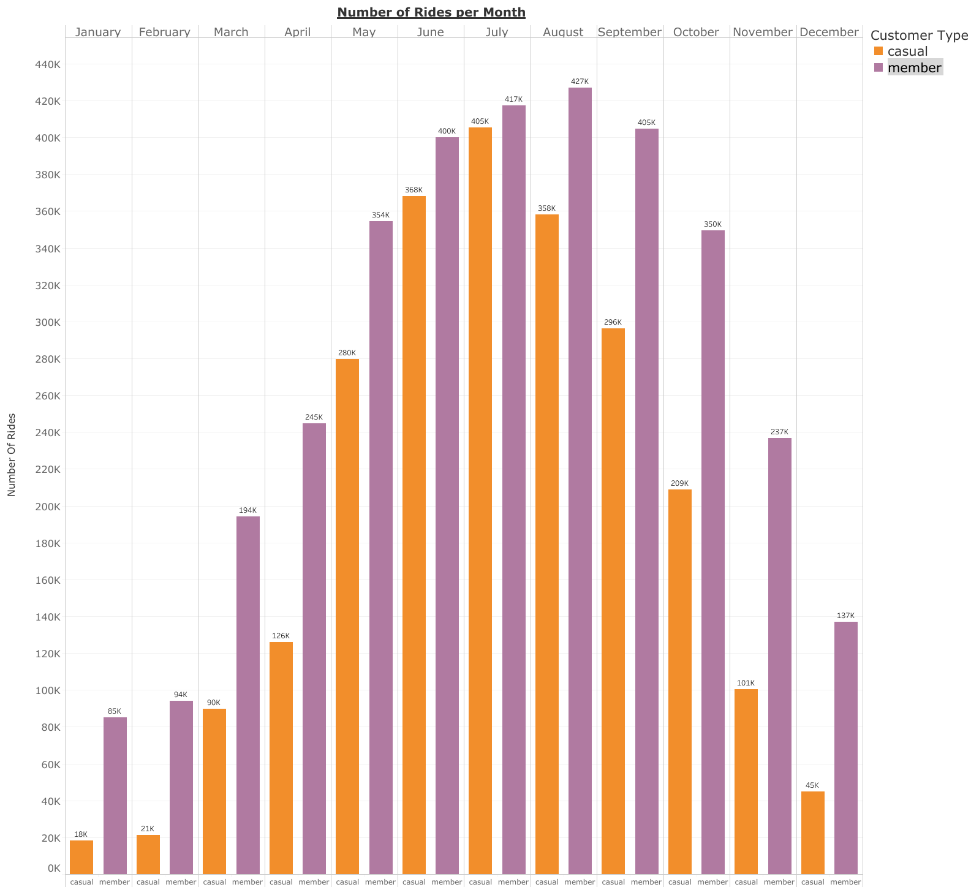
Number of Rides per Month
The effect that warmer months has on rider behavior is even clearer to see when looking at the total number of rides per month, where both casual riders and members have a generally similar trend of increasing in the warmer months and decreasing in the colder months.
In the warmer months, however, the gap between number of casual riders and members is much smaller than the gap between the two in the colder months. This is likely due to members using bikes out of necessity, such as for work, while casual customers are more likely to use for recreation.

Slide 10
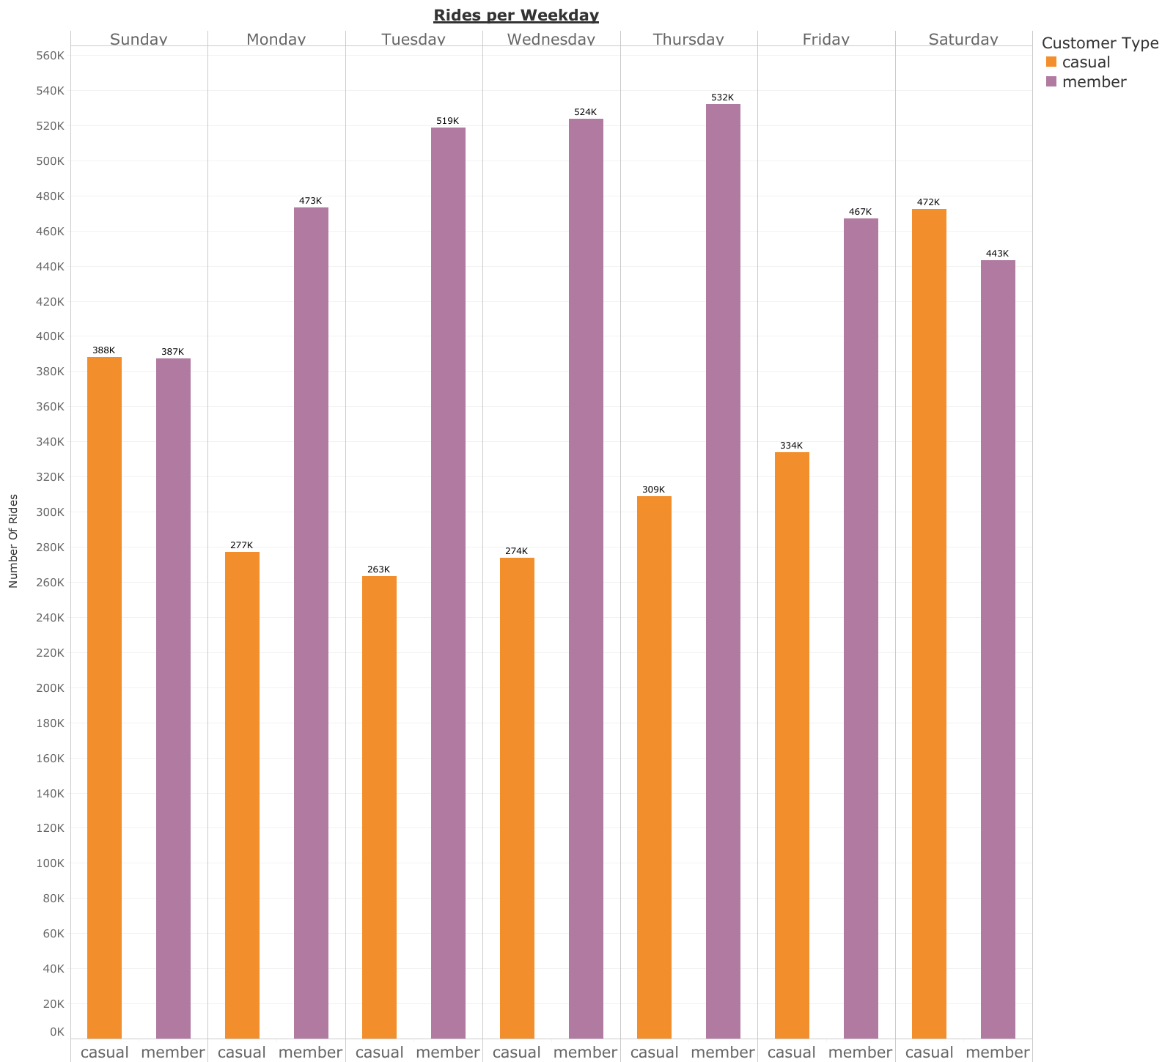
Rides per Weekday
Perhaps the most interesting chart created from the data was the total number of rides per weekday, where the patterns between the two are almost completely opposite.
The total number of rides for both groups are similar on weekends, but weekends serve as the low point in the week for members, and the high point in the week for casual customers.

Slide 11
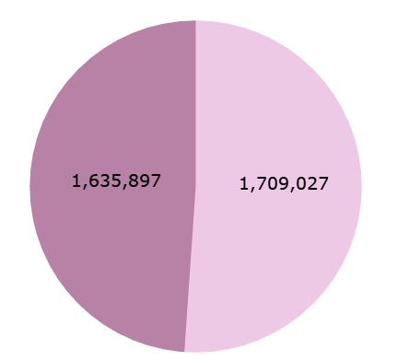

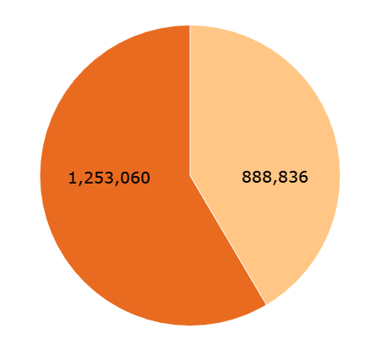

Rides by Bike Type
Lastly, bike type by customer was analyzed to see if one group preferred one bike to the other.
Just under half of all member rides, 49%, were done with an electric bike, while 59% of casual rides were done with an electric bike.
While this may imply that members prefer classic bikes, it is important to consider the possibility that this may simply be a result of there being a lower number of electric bikes to begin with, and because more trips are done by members, many members may be choosing classic bikes because there are no electric bikes available at the time of the ride.
Member rides
Casual rides

Slide 12
Recommendations
Recommendation 1:
As mentioned previously, 59% percent of rides by casual customers were done using electric bikes. However, if it is true that more members are using classic bikes due to the limited availability of electric bikes, it may be possible that the number of casual riders taking electric bikes would be even higher if the supply of electric bikes were increased.
We recommend conducting an analysis on the potential ROI of increasing the supply of electric bikes that are available to both casual customers and members
Electric bikes are easier to ride and require less physical exertion than classic bikes. Casual customers may be more interested in becoming annual members if there were a greater supply of electric bikes to choose from.

Slide 13
Recommendations (Cont.)
Recommendation 2:
More than half of all rides in the year, nearly 54%, occur in just four months, May through August. Because of this, we think it is important to focus on ways to convert casual riders to annual members during the summer months.
Implementing something similar to a “frequent flyer” mileage program may capitalize on casual riders’ tendencies to ride for longer periods of time. If newly signed-up annual members reach a certain mileage within a given timeframe, they could receive discounts on monthly fees as well as other redeemable awards.
Alternatively, providing a gradual discount in rates as the year gets colder may prevent new members who sign up during the summer from cancelling their subscriptions during the winter.

Slide 14
Recommendations (Cont.)
Recommendation 3:
Casual riders are much more likely to ride on weekends than annual members. This suggests that casual riders use bikes for recreational purposes.
Because many people who engage in recreational bike riding often do so with friends or in groups, we believe that adding guest passes as a perk for annual members may serve as an incentive for casual riders to purchase an annual membership.

Slide 15
Additional Data
The following are examples of data that could be considered in the future for further analysis:
Differentiating between casual riders who are local to the Chicago area and casual riders who are visiting from out of town. Chicago-area casual riders, especially those who commute to work using bikes, are casual riders that are more likely to consider purchasing annual memberships.
The number of electric and classis bikes available would likely shed some further light on the difference in choice of bike between casual riders and annual members.
Some routes in the city, such as those with designated bike lanes, are more bike-friendly than others. More info on which routes are safer for bikers than others, as well as surveys asking bikers how safe they feel biking in the city, may provide us with new insights.

Slide 16

Thank You For Your Time!

